Slide 1
Intro to HTML and CSS

Slide 2
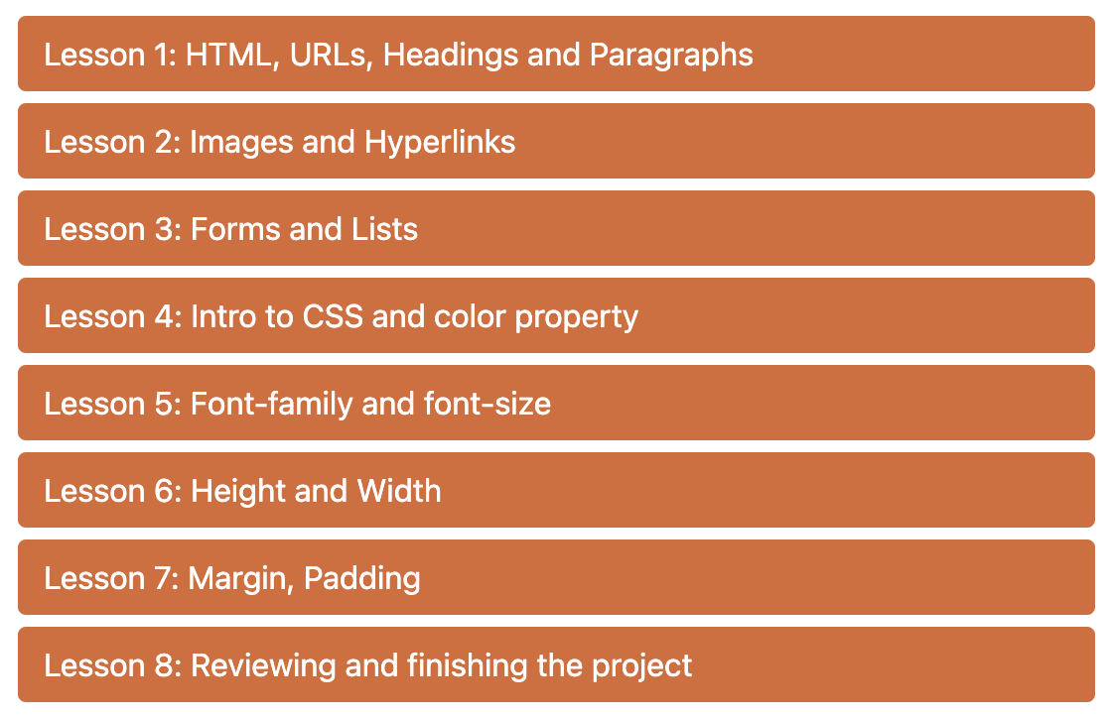
Intro to HTML and CSS
What we will learn
Here is our course outline below. We will be creating a pizza store website throughout our lessons.

Slide 3
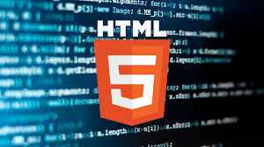
Intro to HTML and CSS
What is HTML?
HTML stands for Hypertext Markup Language. HTML (which is a front-end language) defines the meaning and structure of a website. It is the most basic building block of the Web. The other two important languages for the web is CSS and JavaScript. It creates all the basic content on the web.
You can also look at HTML, CSS, and JavaScript this way:
HTML is the structure of a car
CSS is the interior and exterior decor
Javascript is the electricity, locking the door, and many other functional features that make the car usable.(Not covered in this course)

Slide 4

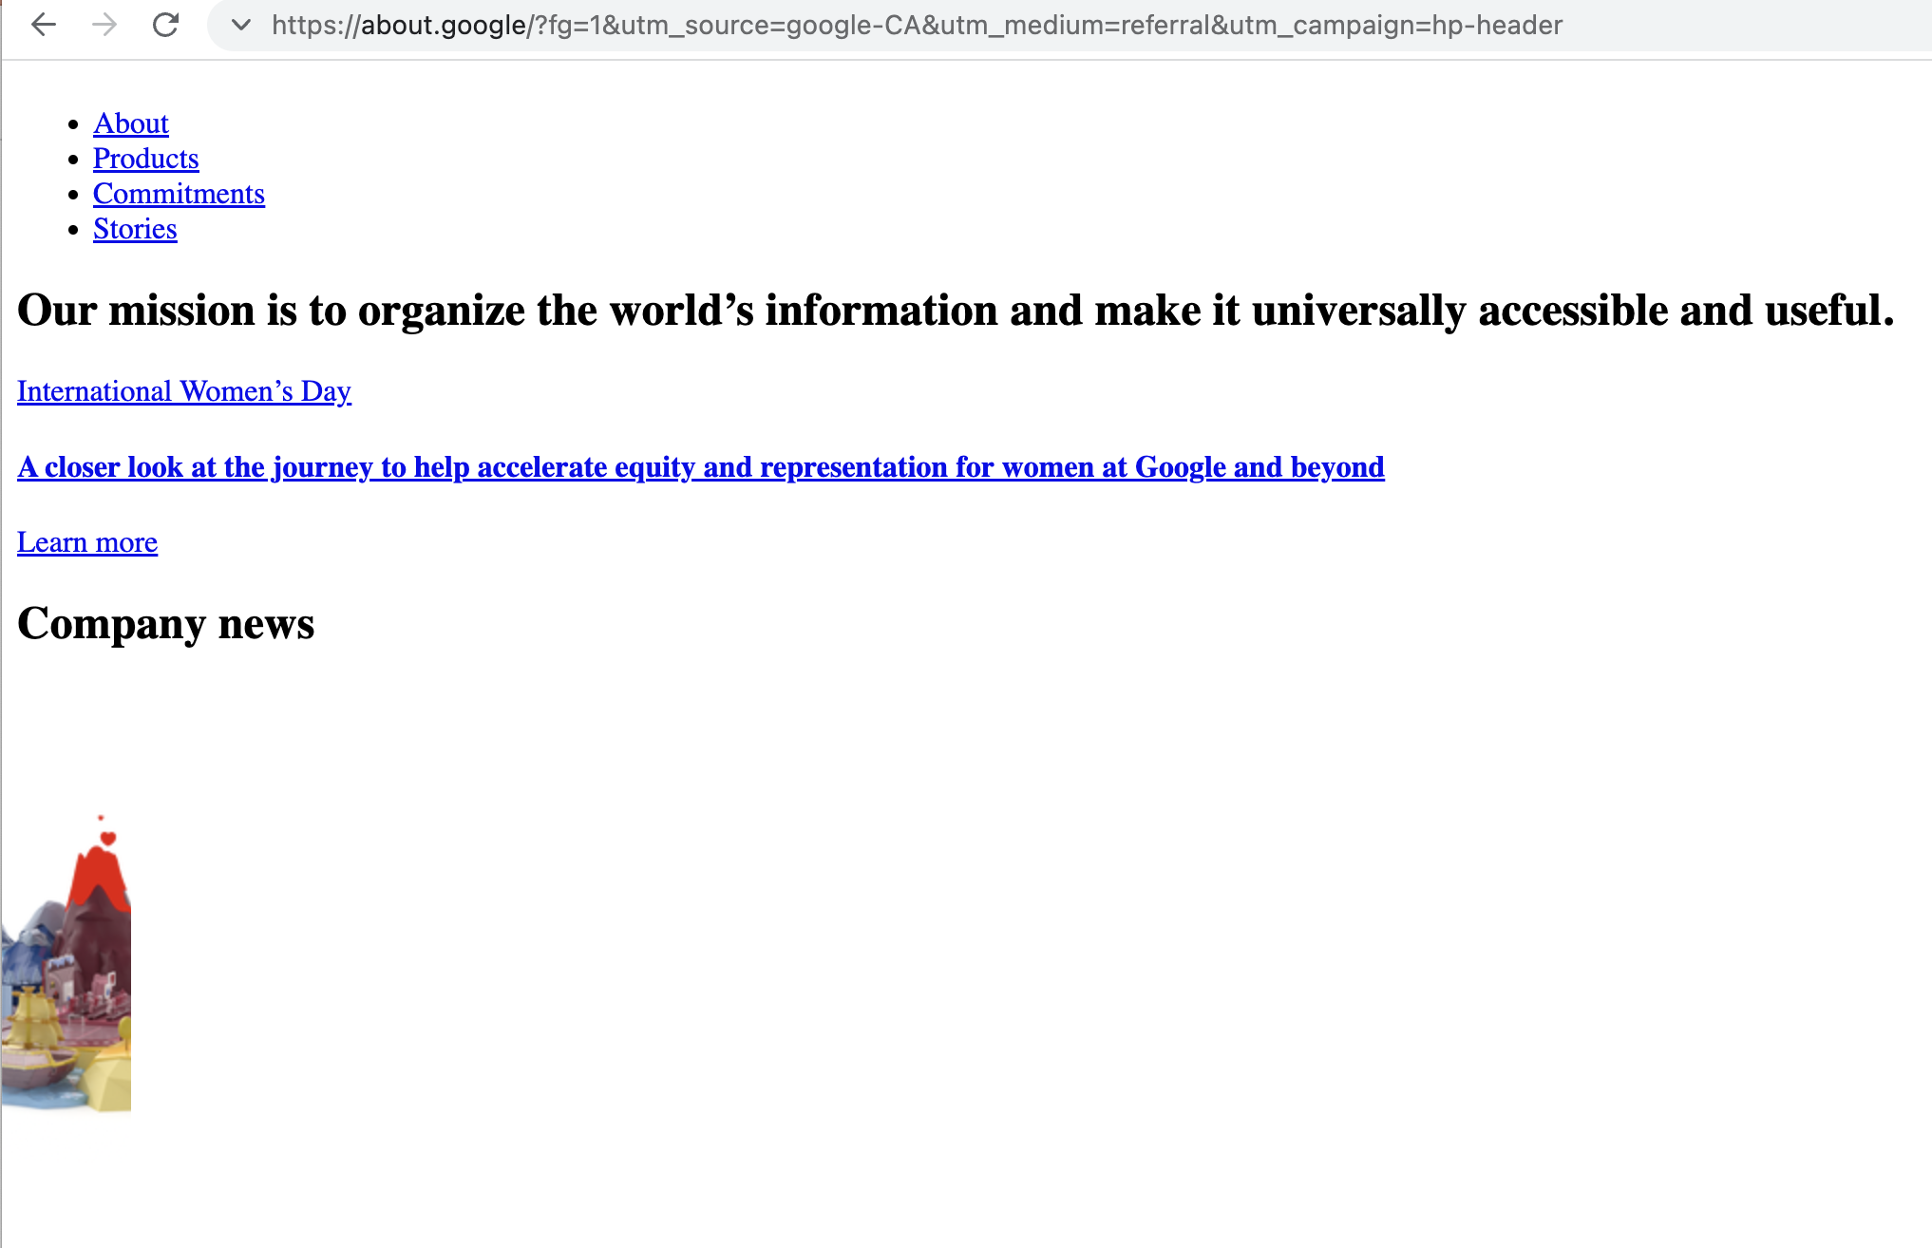
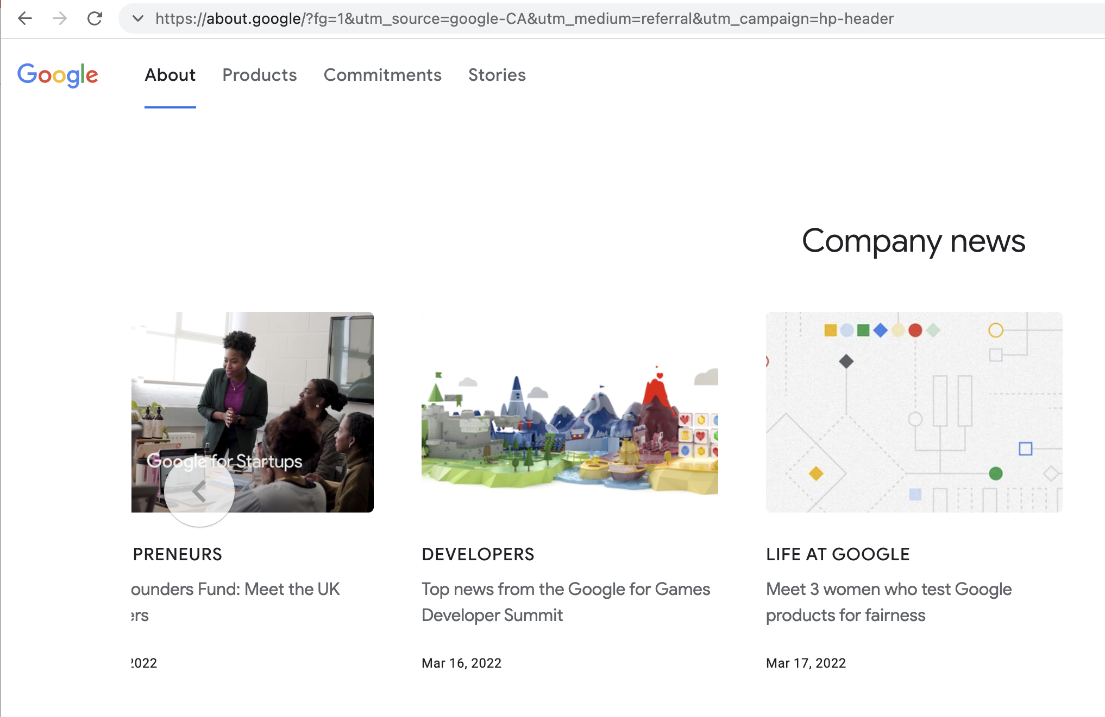
Intro to HTML and CSS
What is CSS?
CSS stands for Cascading Style Sheets. CSS is a design language to add style to your website. It makes your website look more appealing than just plain or uninspiring pieces of text. CSS makes the front-end of a website shine and it creates a great user experience.
It is a very important language in web development.
With CSS:
Without CSS

Slide 5
Intro to HTML and CSS
What you need to prepare
Use a computer to come to class
Practice typing (https://www.typing.com/student/lessons and https://play.typeracer.com/)
Try to be able to install software on your computer (we will need to install a text editor)

Slide 6

Intro to HTML and CSS
Any Questions

Slide 7
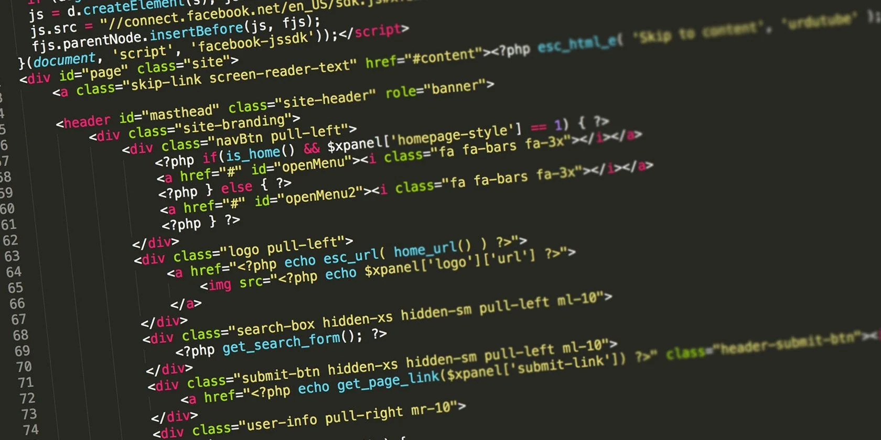
Intro to HTML and CSS
HTML Syntax
HTML is a markup language that consists primarily of tags that are enclosed inside angle brackets, for example, <p>. Most tags are paired to indicate the start and end of the text being marked up; an end tag is formed by including the tag inside the angle brackets with a forward slash, for example, </p>.

Slide 8
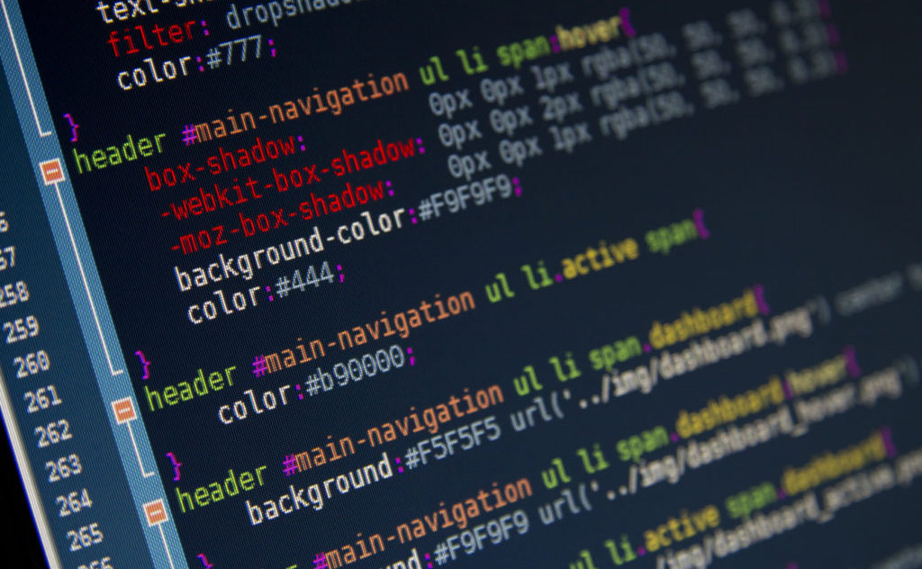
Intro to HTML and CSS
CSS Syntax
A CSS Syntax rule consists of a selector, property, and its value. The selector points to the HTML element where CSS style is to be applied. The CSS property is separated by semicolons. It is a combination of selector name followed by the property: value pair that is defined for the specific selector.
Syntax:
selector {
property: value;
}

Slide 9
Common mistakes
Here are some common mistakes (and recommendations) in HTML:
• there are spaces inside the tag(e.g. < html >)
• the closing tag doesn’t have a forward slash(“/”) e.g. <title>Title<title>
• tag names are sometimes spelled wrong
• there is no space after a field’s double quotation mark or single quotation mark(e.g. <a href=“atom.io”target=“_blank”>Atom</a>)
Recommendations:
• don’t use capitals for your tag names(e.g. <HEAD>)

Slide 10
HTML Structure
HTML Structure
Each element follows this structure (some exceptions):
A start tag -> Value -> An end tag. To create an end tag, put a “/” after “<“.
E.g. <h1>Hello World</h1>

Slide 11
Headings and Paragraphs
What are paragraphs in HTML?
What are headings in HTML?
HTML paragraphs are exactly what it sounds like – It is a paragraph, or a block of text.
The way to define HTML paragraphs is
<p>Text</p>
The <h1>, <h2>, … <h6> tags creates a title or subtitle.
The <h1> tag creates the biggest heading
and the size decreases as the number beside
the h gets smaller.
<h6> is the smallest header.

Slide 12
Homework
1.

